Slide 1
The Freescale Cup
- Layer Programming-
- HAL, MAL and Application -
- Structured Programming -
- Modular Programming -
- Templates -
<number> / Author / Date © Continental AG

Slide 2

- Layer Programming -
What is the Layer Programming?
A layer programming is one programming style that pursues like main objective the separation of the logic design into levels according to their common functionality.
Why to use?
This kind of architecture can achieve a lot of easy levels (depends on the system complexity) , each one abstracted from the rest and with specific functions. Typically known like “Black Box” .
Advantages:
  Easy tasks in every level with a common objective
  When changes are coming, just attack the affected level
  Easily scalable, can add more layers or levels if needed
<number> / Carlos Calvillo – Edgar Perez-Enrique Rodríguez/ Date © Continental AG
Notes:
Tools: Debugger
Metods: Distintos Modelos de Desarrollo de Software (como cascada, extreme programming)
El ejemplo mas claro de procesos y modelos de proceso se da en la practica médica.
Las intervenciones quirúrgicas se llevan acabo siguiendo un cierto numero de pasos bien definidos, y se hace de esa manera porque han demostrado su efectividad.
En el desarrollo de software también se tienen procesos y modelos que han probado se efectivos en el desarrollo de productos.

Slide 3
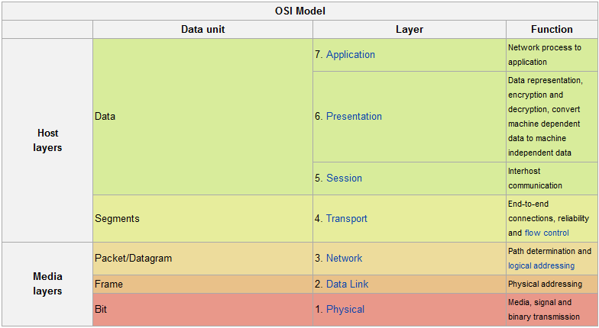
- Example of Layer Programming, the OSI Model -
<number> / Carlos Calvillo – Edgar Perez-Enrique Rodríguez/ Date © Continental AG

Slide 4
- Typically architecture for Layer Programming-
Hardware Abstraction Layer (HAL)
Firmware Abstraction Layer
Assembly Language Abstraction Layer
Kernel Abstraction Layer
Operative System Abstraction Layer
Application Abstraction Layer
Embedded Systems Vision
Hardware Abstraction Layer (HAL)
Middleware Abstraction Layer (MAL)
Application Abstraction Layer
<number> / Carlos Calvillo – Edgar Perez-Enrique Rodríguez/ Date © Continental AG

Slide 5
- Hardware Abstraction Layer (HAL) -
Is an abstraction layer, implemented in software, between the physical hardware of a system and the software that runs on that system. Its function is to hide differences in hardware from most of the operating system kernel, so that most of the code does not need to be changed to run on systems with different hardware. Contains sets of routines in software that emulate some platform-specific details, giving programs direct access to the hardware resources.
Systems having a defined HAL are easily portable across different hardware. This is especially important for embedded systems that run on dozens of different platforms. Best known like drivers.
<number> / Carlos Calvillo – Edgar Perez-Enrique Rodríguez/ Date © Continental AG

Slide 6
- Middleware Abstraction Layer (MAL) -
Is a software layer that sits "in the middle" between the embedded application and the real time operating system (RTOS). Examples include protocol stack software, Operating System Abstraction Layer and possibly memory management modules.
For Embedded Systems, middleware is generally used in the context of the high level architecture (HLA) that applies to many distributed simulations. It is a layer of software that lies between the application code and the run-time infrastructure. Middleware generally consists of a library of functions, and enables a number of applications–simulations or federates in HLA terminology—to page these functions from the common library rather than re-create them for each application.
<number> / Carlos Calvillo – Edgar Perez/ Date © Continental AG

Slide 7
- Middleware Abstraction Layer (MAL) -
Advantages:
Locate transparently across the network, thus providing interaction with another service or application
Filter data to make them friendly usable or public to the rest of the application layer
Be independent from network services
Be reliable and always available
In case that a new function is required for many systems just need to update the middleware.
<number> / Carlos Calvillo – Edgar Perez/ Date © Continental AG

Slide 8
- Application -
Contains the main body of the code, this layer has all the routines that are required to us. All the functionalities that we need to implement using our hardware is here.
Using this model of layers provide an easy way to update a code if its needed a migration from one hardware system to another one. Also, if we need new functionalities its no need for update the HAL or the MAL and just create the new code.
In the industry, one of the main points is portability. The change of hardware is very common in all the systems due to production costs, not more production of a certain component, etc., and using this kind of layer structure the migration is easier because its no needed to create all the code again, just update the necessary layer. Also, in certain times a client ask for the same functionality used for other projects of themselves but working in new different hardware; this is known like carry over.
<number> / Carlos Calvillo – Edgar Perez/ Date © Continental AG

Slide 9
- Structured Programming -
Structured programming is a technique of codification that have the capability of explain the programs clearly. This uses only three structures: sequence, conditional andi teration being unnecessary to use the statement or unconditional transfer(GOTO, EXIT FUNCTION RETURN EXIT SUB or multiple).
This kind of technique make the code easy to read and improve, using basically just one way in the code (one entry, one exit).
The structured program shows that any program can be written using only the following three instructions of control:
Sequence
Conditional statement.
Iteration (loop instructions) with condition at the beginning.
Only these three structures can write all possible programs and applications. Although programming languages ​​have a greater repertoire of control structures, they can be constructed using the three basic above.
<number> / Carlos Calvillo – Edgar Perez/ Date © Continental AG

Slide 10
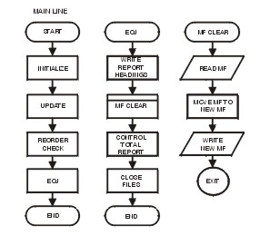
- Structured Programming -
Advantages:
The programs are easier to understand, can be read sequentially, there is no need for tracking in line breaks (GOTO) within blocks of code to try to understand the logic.
The program structure is clear, since the instructions are more connected or related.
Reducing effort in testing and debugging. The monitoring of faults or errors in the program ("debugging") is facilitated due to its more simple and understandable, so that errors can be detected and corrected more easily.
Reduced maintenance costs. Similar to debugging, during the maintenance phase, modify or extend programs easier.
Programs are easier and quicker to make (and facilitates optimization).
Code blocks are almost self-explanatory, which reduces and facilitates the documentation.
<number> / Carlos Calvillo – Edgar Perez/ Date © Continental AG

Slide 11
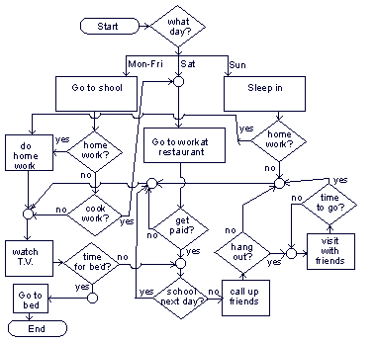
- Structured Programming -
Disadvantages
The main drawback of this method of programming is that you get a single program block, when it gets too big can be a problem managing your source code, this is solved jointly using modular programming.
<number> / Carlos Calvillo – Edgar Perez/ Date © Continental AG

Slide 12
- Modular Programming -
Modular programming is a programming paradigm that involves dividing a program into modules or applets to make it more readable and manageable.
It’s presented as an evolution of structured programming to solve problems larger and more complex than it can solve.
Applying modular programming, a complex problem must be divided into several simpler subproblems, and these in turn into other simpler subproblems. This should be done until subproblems simple enough to be easily solved with a easy implementation.
<number> / Carlos Calvillo – Edgar Perez/ Date © Continental AG

Slide 13
- Modular Programming -
  A module is each one of the parts of a program that solves one of the subproblems created by the division of the original complex problem. Each of these modules has a well-defined task and maybe need other modules need to operate. In this case, the modules can communicate with it via a communication interface must also be well defined.
  When this communication is doing by using events, we call it like a state machine programming.
<number> / Carlos Calvillo – Edgar Perez/ Date © Continental AG

